Slide 1

The Battle of Neighborhoods – Dallas, Texas
By,
Janaranjani Kannan

Slide 2

Business Problem
An entrepreneur wants to open a tutoring center in Dallas, Texas.
He wants to use Data Science to help him locate the best neighborhood to establish a tutoring center which will have high success rate.

Slide 3
Business Objective
Middle Aged families whose lives revolve around their children.
Medium to High Income Families who can afford to send their children to tutoring centers.
Highly Populated neighborhood.
No other tutoring/learning center within a radius of 2000 meters

Slide 4

Data acquisition and cleaning

Slide 5
Data source and feature selection
Data wrange and cleaning
We need the following features from ‘www.city-data.com’ portal.
City
Neighborhood Name
Population per neighborhood
Median Household Income per neighborhood
Male average age per neighborhood
Female average age per neighborhood
We can use the module “Geopy” to retrieve Latitude and Longitude based on neighborhood address.
We can use Four Square API endpoint: “explore” to obtain top 100 venues that are within a radius of 2000 meters
Remove duplicate entries.
Drop rows if any of its cells have NaN instead of real data.
Remove cumulative population number entries such as North Dallas, East Dallas, Far North West Dallas etc since each of these locations are further divided into many neighborhoods which are already part of the dataset.
Consider neighborhoods with population more than 5000.

Slide 6

Methodology

Slide 7
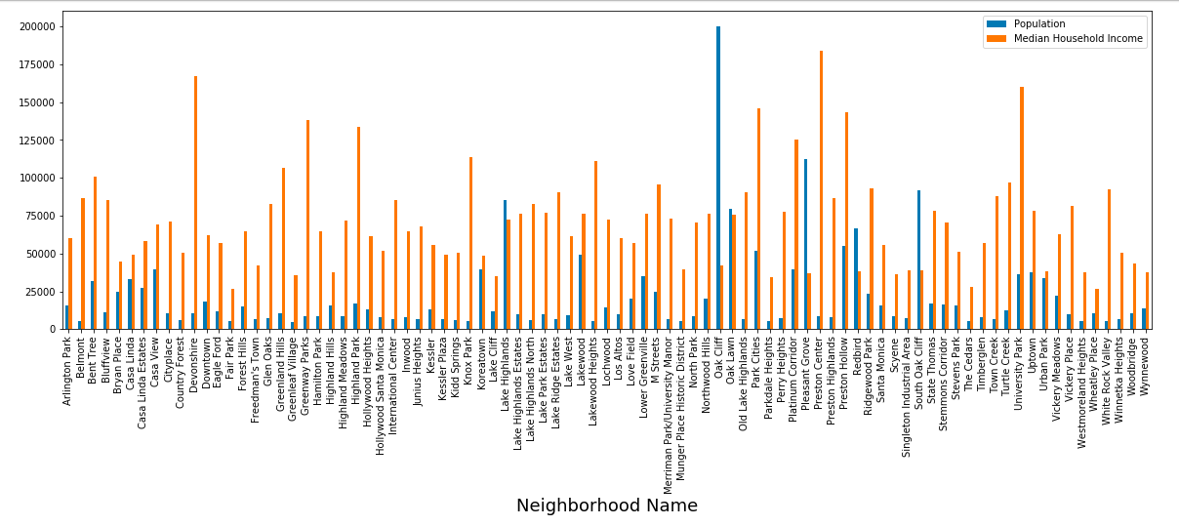
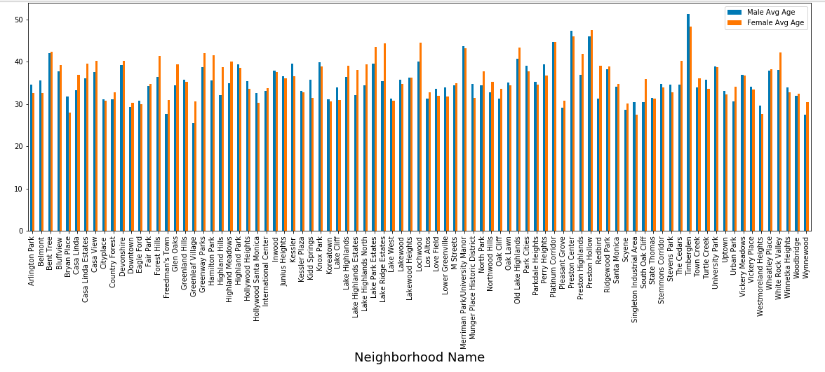
Exploratory Data Analysis
Let’s compare the features: Population vs Household Income and Male/Female average age in each neighborhood to understand the dataset.
Per picture on the right, most of the neighborhood consists of middle-aged male/female. Per picture on the left, most populous neighborhood doesn’t meet our income criteria. Hence, we need to find some balance between these 4 features in our final dataset to find the perfect neighborhood for our client.

Slide 8
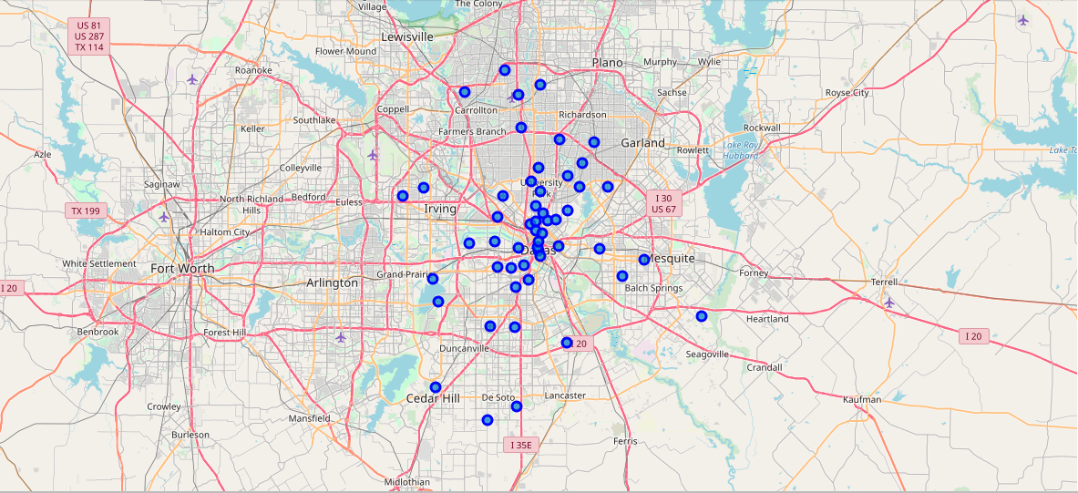
Data visualization before clustering
Initial map of Texas with Dallas neighborhoods superimposed on top.

Slide 9
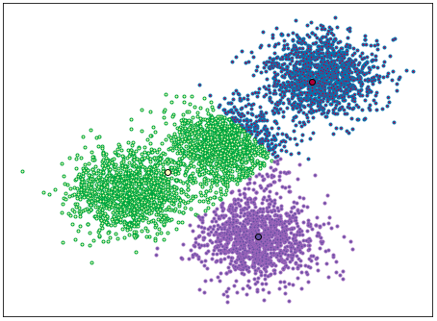
Predictive Modeling (Machine Learning algorithm selection)
The K-means machine learning algorithm is used for clustering if you need to quickly discover insights from unlabeled data.
We are going to use k-Means clustering algorithm for neighborhood segmentation since we use unlabeled data.
Some real-world applications of k-means:
Customer segmentation
Understand what the visitors of a website are trying to accomplish
Pattern recognition
Machine learning
Data compression

Slide 10
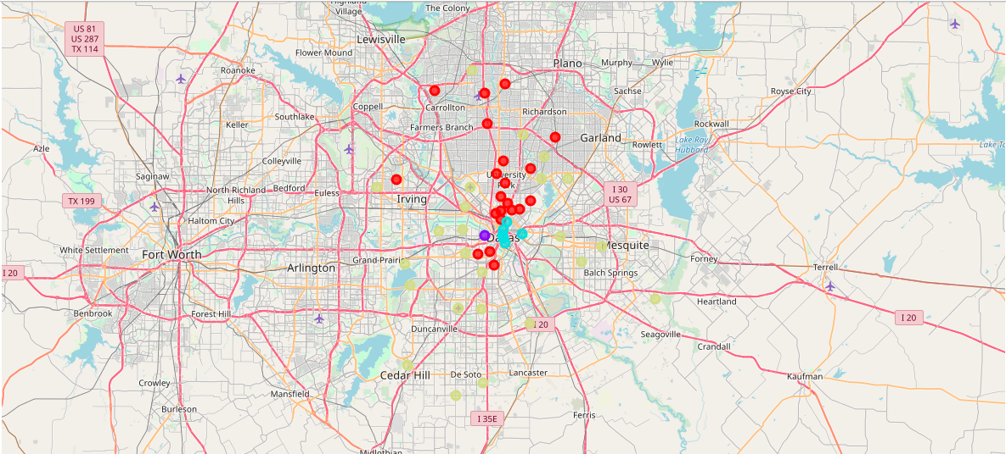
Data visualization after clustering
Map of Texas with Dallas neighborhoods superimposed on top.

Slide 11
Discussion
Neighborhoods are segmented into 4 clusters, each one maps to a specific neighborhood.
Ethnic
Urban Pioneer
Urban Core (Downtown)
Cul-de-sacs & Kids
Immigrants from a particular ethnicity, young couples, budget-conscious singles.
Near downtown and inner-ring suburbs.
Downtown, the heart of major metros.
Middle-aged soccer moms and dads whose lives revolve around their children.
Per our business objective, we are looking for a ‘Cul-de-sacs & Kids’ neighborhood type which is populated with middle-aged soccer moms and dads whose lives revolve around their children.

Slide 12
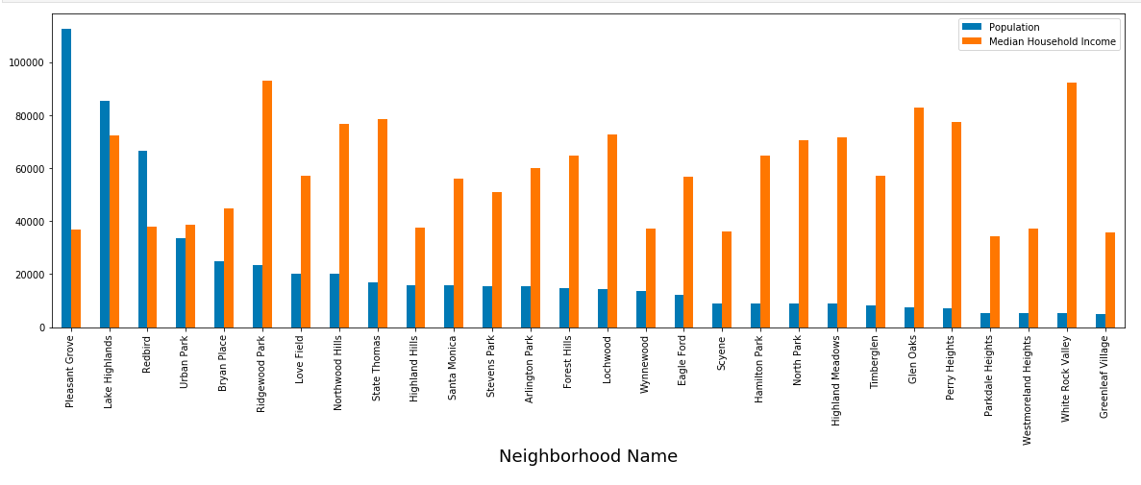
Conclusion
Based on the data analysis (per the combination of the features such as Population, Median Household Income, Male/Female average age and Venues list) and Kmeans clusters(neighborhood types), we can conclude that Lake Highlands (instead of ‘Pleasant Grove’ since the Income feature is not satisfactory) is the perfect neighborhood to start the first tutoring center in Dallas by the client.

Slide 13
Thank you

